Slide 1
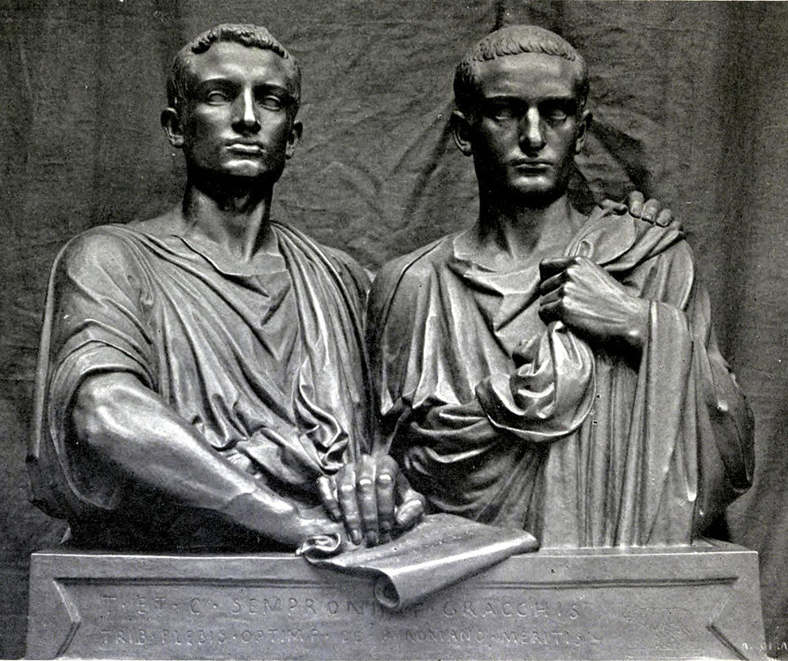
The Late Roman Republic
GOAL/S: Identify the features of the Late Roman Republic
Describe the Gracchi Brothers
Week 4, Lesson 1

Slide 2
REVIEW – Where are we up to?
Term/Week | Topic/Content | Assessments
T1 - 1 | Roman Society Overview
T1 - 2 - 3 | Roman Soc/Pol/Eco/Religion/Cul
T1 – 4 - 6 | Tiberius and Gaius Gracchus (133 – 121 BCE) | Essay (Week 6 – 10%)
T1 – 7 - 9 | Gaius Marius (133 – 87 BCE) | Source Analysis (Week 9 – 10%)
T2 – 1 - 3 | Sulla (90 – 78 BCE)
T2 – 4 – 5 | EST | EST (Week 4 – 5 – 15%)
T2 – 5 - 6 | Pompey to 66 BCE | Historical Inquiry (Week 5 – 6 – 10%)
T2 - 7 | EXAMS

Slide 3
The period from the Late Republic to the Lex Manilia (c. 133–66 BCE) in ancient Rome was marked by significant political, social, and military developments that played a crucial role in shaping the destiny of the Roman Republic.

Slide 4
The Late Roman Republic - features
Political instability and factional struggles where powerful individuals (such as the populares/ optimates) vied for control over the state.
Social and economic challenges: territorial expansion led to economic changes creating economic inequality, land distribution problems, and social unrest.
Rise of military commanders (like Marius and Sulla) demonstrated the increasing influence of individual generals on Roman affairs.
Reform attempts (e.g. land distribution) were made by Tiberius and Gaius Gracchus.
Tiberius Gracchus, through the lex agraria, sought to address the plight of impoverished farmers, while Gaius Gracchus continued these efforts, advocating for broader social and economic reforms.

Slide 5
The Late Roman Republic - features
Social unrest and violence including political assassinations and clashes between rival factions.
The Social War (91–88 BCE)
Conflicts between Marius and Sulla
The Lex Manilia (66BCE – ‘extraordinary powers’) highlighted the increasing reliance on individual military commanders to address external threats: trend toward the concentration of power.
Expansion of Roman territories, engaging in conflicts in the Mediterranean and beyond which brought both wealth and managing challenges
Sulla's Dictatorship in 82 BCE was a notable departure from the traditional Roman Republican system, and he implemented a series of political reforms to consolidate his power.

Slide 6
The Late Republic to the Lex Manilia period in ancient Rome was marked by internal strife, social and economic challenges, the rise of powerful military commanders, and a shifting political landscape. These developments set the stage for further transformations in Roman governance and contributed to the eventual transition from the Roman Republic to the Roman Empire.

Slide 7
Watch the following
https://www.youtube.com/watch?v=ODI1VOOoey0&ab_channel=ExtraHistory

Slide 8
ACTIVITY – Tiberius and Gaius Gracchus
Get a highlighter or Red pen
As a class, we will read through the text ‘The Gracchi Brothers)
Stick the information worksheet in your book
Create an A4 Information Poster about the Gracchi brothers – this will be displayed

